Slide 1



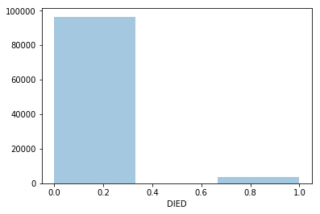
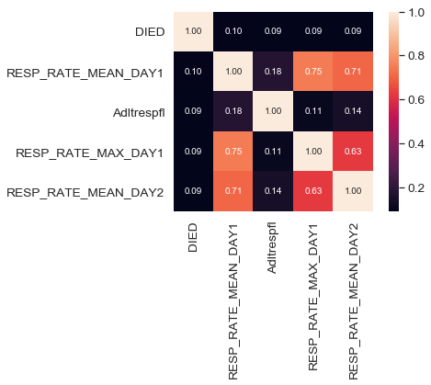
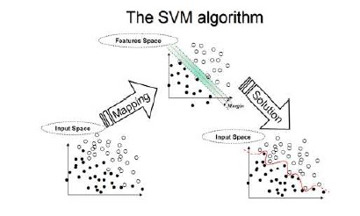
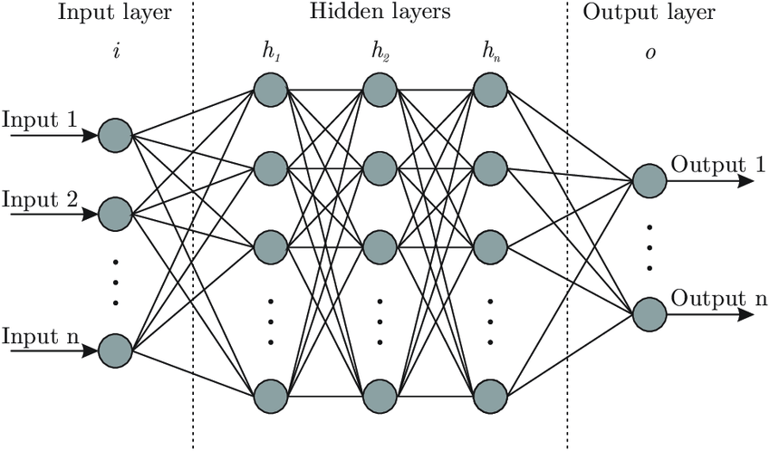
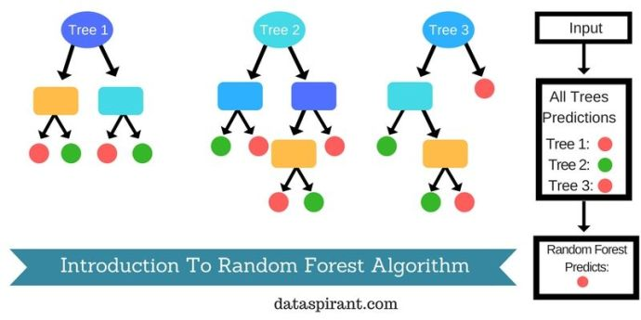
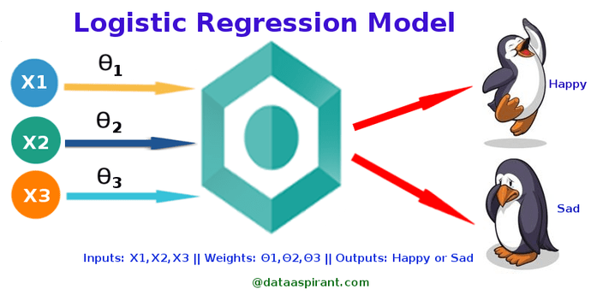

To be, or not to be?
Mortality Prediction : To Be or Not To Be
Shreya, Akash Verma,
Shridhar Thakur, Archit Gupta
Indrajeet Gupta
Abstract
Experimental Results and Discussion
In these past years, there is a increase in interest towards data mining, artificial intelligence and machine learning concepts to improve hospital performance. In some hospitals, they want to improve their statists by decreasing the number of patients dying in the hospital. The Research is focused in mortality, prediction of measurable outcomes, including risk of complications & length of hospital stay. The duration spent in the hospital plays an important role both for patients & healthcare providers , influenced by numerous factors. In particular LOS(length of stay) in critical care is of great importance, both to patient experience as well as the cost of care, and is influenced by the complex environment factors of the Hospitals. LOS is a parameter which is used to identify extremity of illness & health related resource utilisation. This paper examines the case of either a patient survives or dies in the range of length of stay in the hospital. It also anchors the analytical methods for length of stay and mortality prediction
Following are the results we got from various Models:
Table: 1 Description of Models
Model | Description | Score
1. Linear SVM | Classification by finding the hyper plane | 0.7513
2. Gaussian Naïve | P(h)d = (P(d|h)* P(h)) / P(d) | 0.6124
3. Logistic Regression | Estimating the parameters using a logical function | 0.7576
4. Percepton | Learn the weights to get the function | 0.7300
5. Decision Tree | Uses a tree like model with conditional control statements | 0.5354
Introduction
It is rightly said that ‘Health is Wealth’. A healthy life is a blessing. Due to some unfortunate incident a person may get injured or may incur some disease. In hospitals, due to the increase in number of patients per doctor, a patient may not get the required treatment in proper time. Here is where technology comes into role. One of the emerging technologies is Machine Learning where a model can help boost up the prediction of critical conditions and helps to take prevention at an early stage.
Everyday enormous information is collected by the doctors and nurses about patients to monitor their health state, diagnose and chose treatments. It can also be used for statistical predictive analysis. We have been provided with a dataset of about 80,000 patients with 342 features and the task is to classify whether the patients dies or not represented by 1 and 0 resp. This is a highly imbalanced dataset as fortunately only 2700 patients die and the rest survive. The task at hand is to predict a patient’s chances of survival. Our aim would be to get as high accuracy as possible by trying various machine learning models.
Figure 7: Models Accuracy Graph
From the above graph we can get an idea about the best suitable approach for this problem. LogisticRegression and Support Vector Machine algorithms will be best suited for this binary classification problem where there is a highly imbalanced dataset and chances of overfitting.
Figure 1: Intersection of technology and medical field
Figure 2: Probability distribution of survival
Proposed Method
Figure 3: Support Vector Machines (SVM) for classification problem
Figure 4: Artificial Neural Networks
Figure 8: Correlation Matrix for feature extraction
These are a few of the many models we applied to train the machine. The missing data values were filled with the mean of the respective column. One-hot encoding was used for treating the categorical values. We also plotted a correlation heat map for best feature extraction. To treat the wide range of data, Min-Max Scalar was applied to scale the data in the range of 0-1.
Conclusions
1. The dataset provided by CodaLab has numerical and string data related to the medical information of the patient needs some reapirs.
2.The data was preprocessed and trained our dataset with 5 models(Support Vector Machine, Gaussian Naïve Bayes, Logistic Regression, Perceptron, Decision Tree). Among all the models Logistic Regression gave us the best score of all with 75.76% accuracy.
3. It will be a very helpful framework for the medical institutions.
References
1.Knaus WA, Wagner DP, Draper EA. The APACHE III prognostic system: risk prediction of hospital mortality for critically III hospitalized adults.
2.https://stackoverflow.com/questions/29432629/plot-correlation-matrix-using-pandas
3. https://codalab.lri.fr/competitions/566#participate-get_data
4.https://www.analyticsvidhya.com/blog/2016/12/introduction-to-feature-selection-methods-with-an-example-or-how-to-select-the-right-variables
Figure 5: Random Forest are an ensemble learning method for classification
Figure 6: Logistic Regression
Team No. - 24

